Slide 1
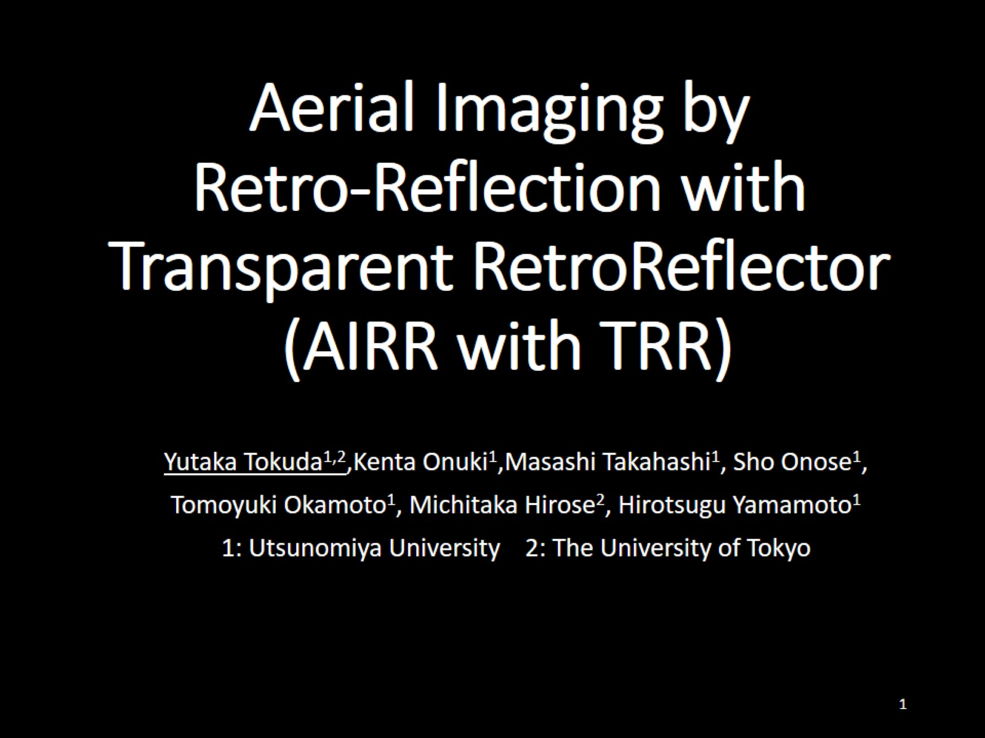
Aerial Imaging by Retro-Reflection with Transparent RetroReflector (AIRR with TRR)

Slide 2
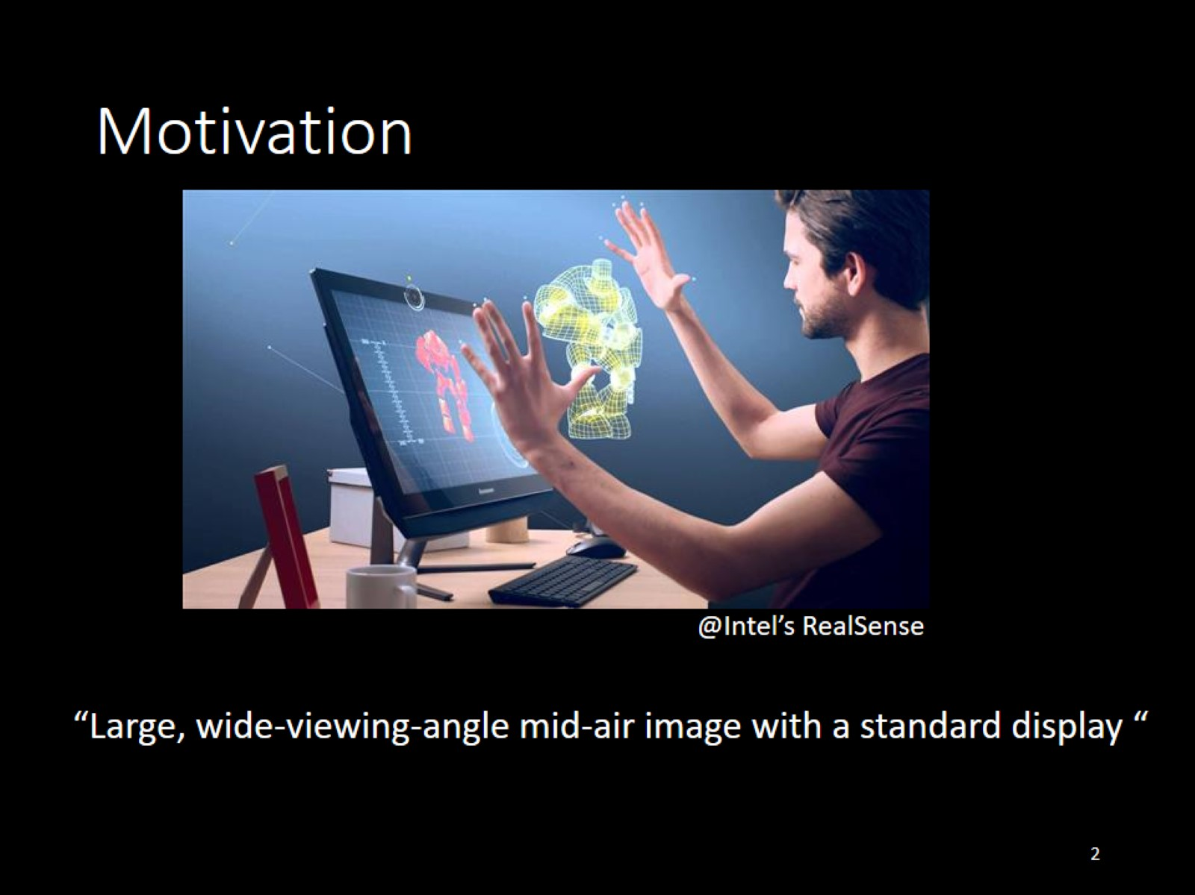
Motivation

Slide 3
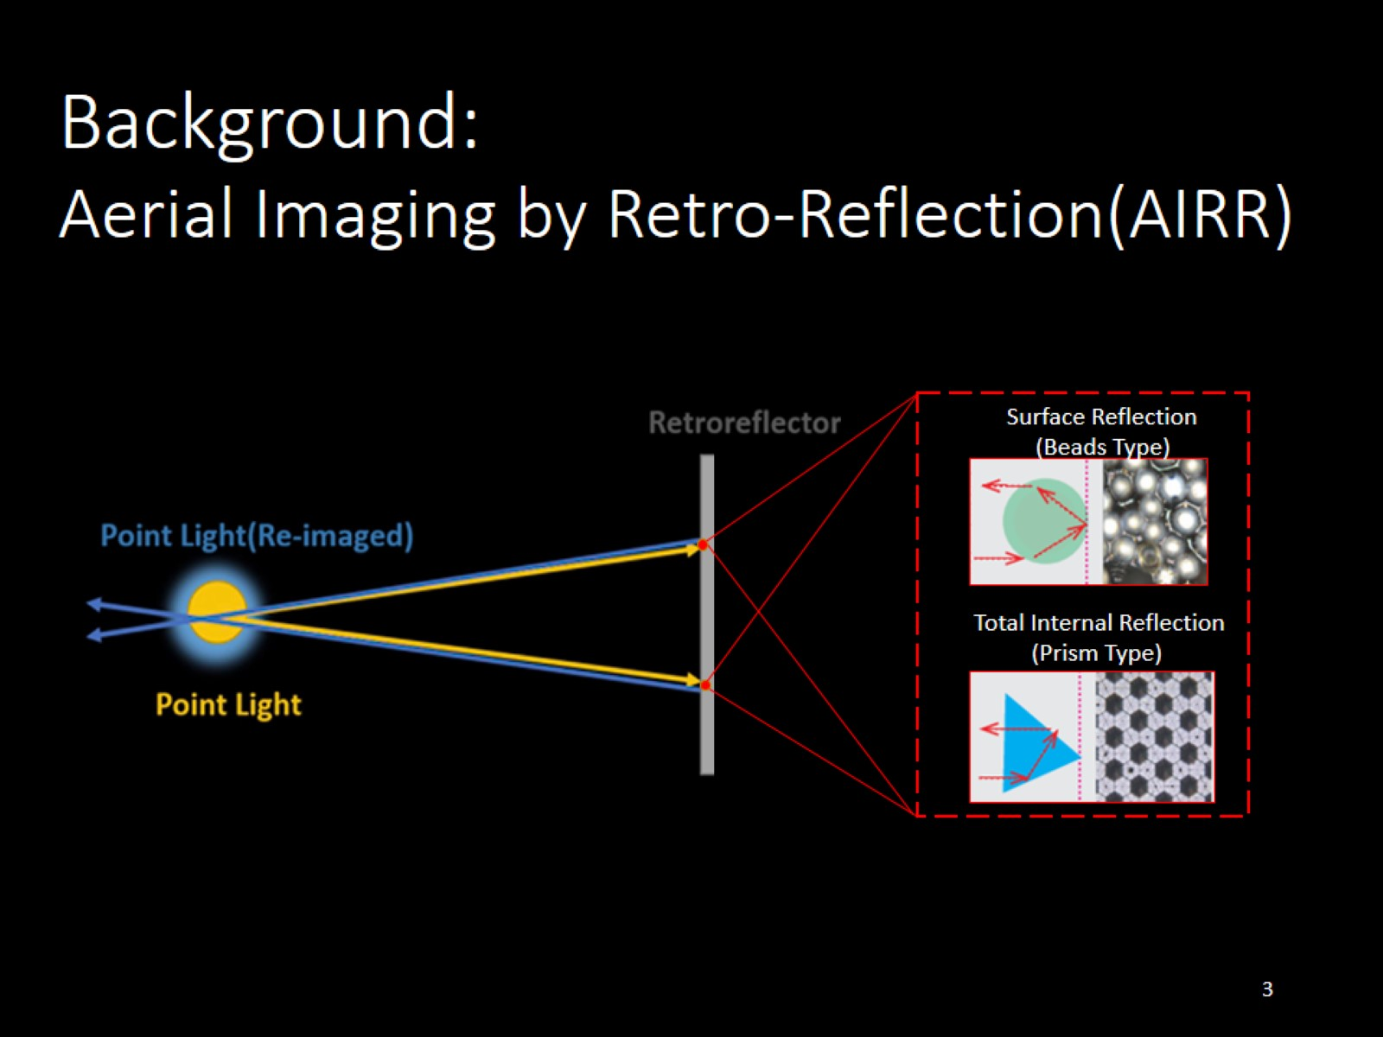
Aerial Imaging by Retro-Reflection(AIRR)

Slide 4
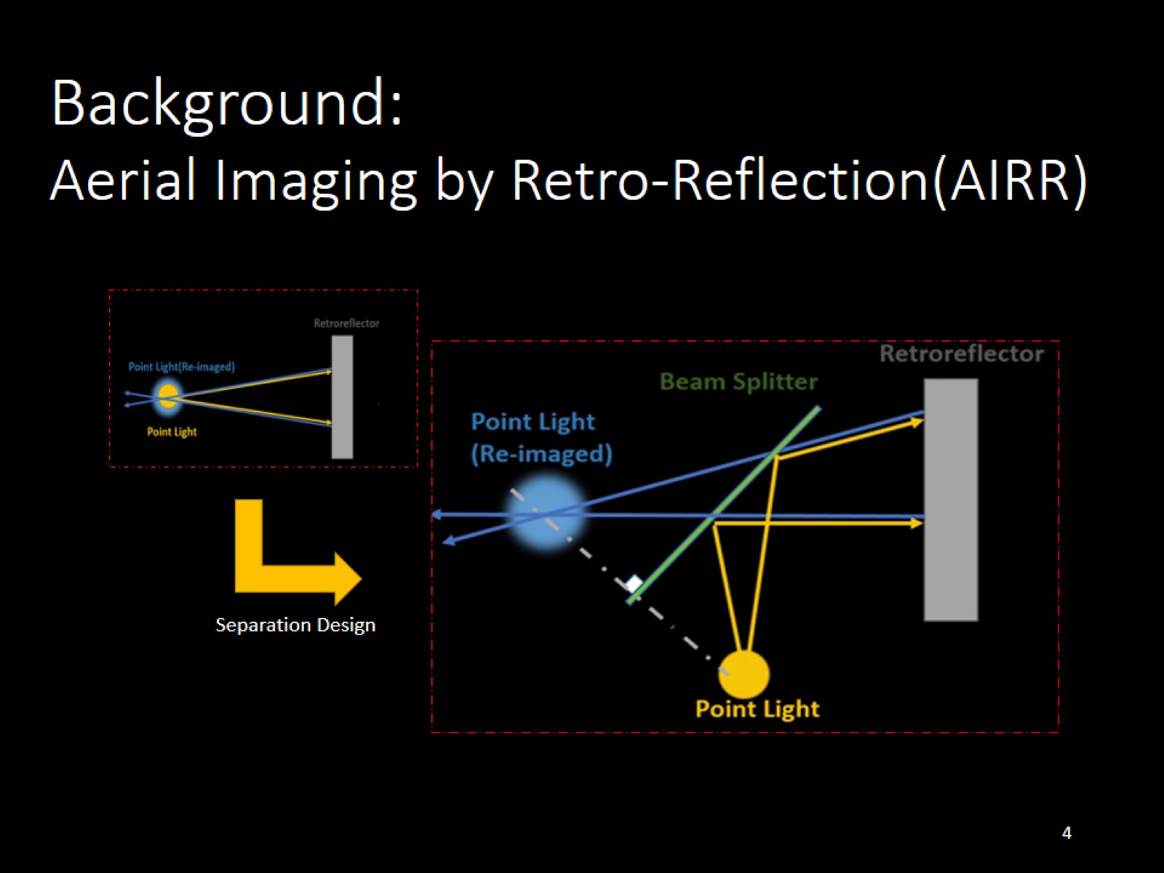
Aerial Imaging by Retro-Reflection(AIRR)

Slide 5
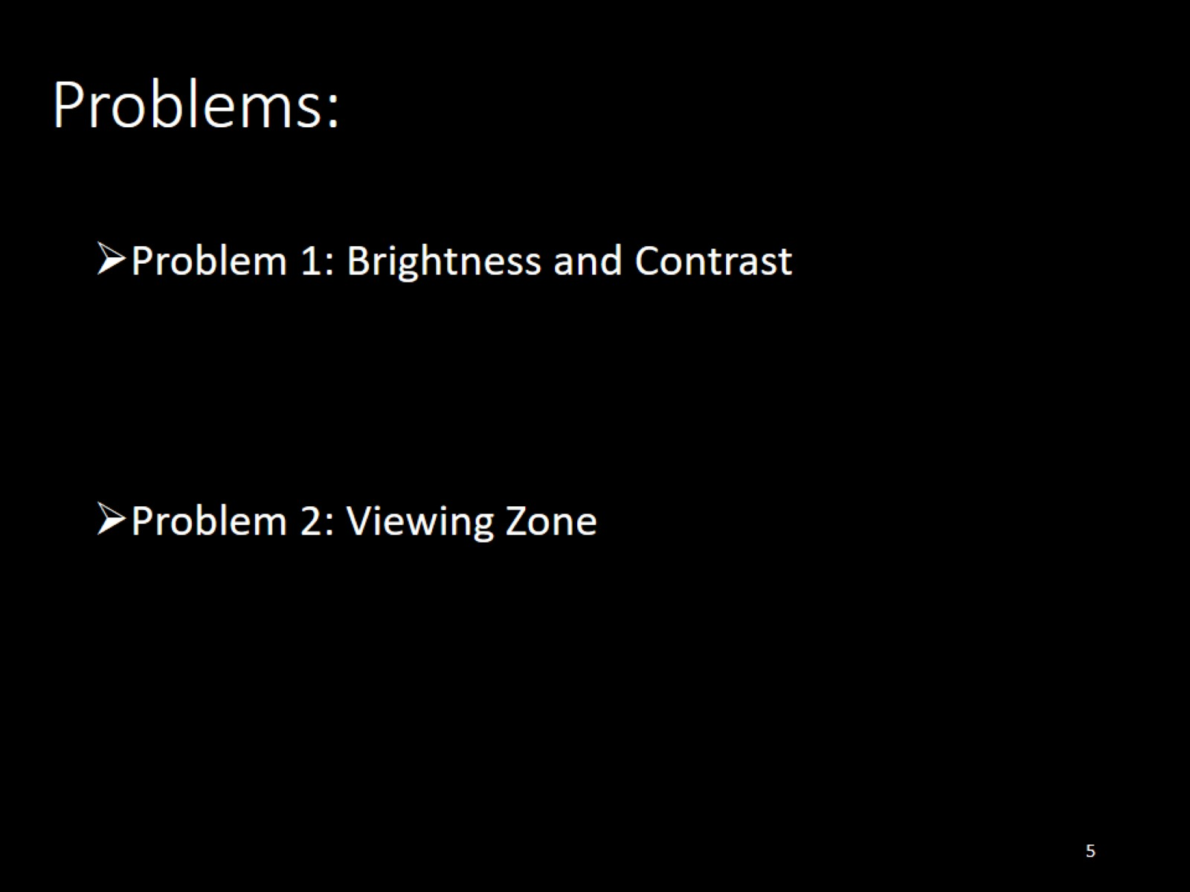

Slide 6
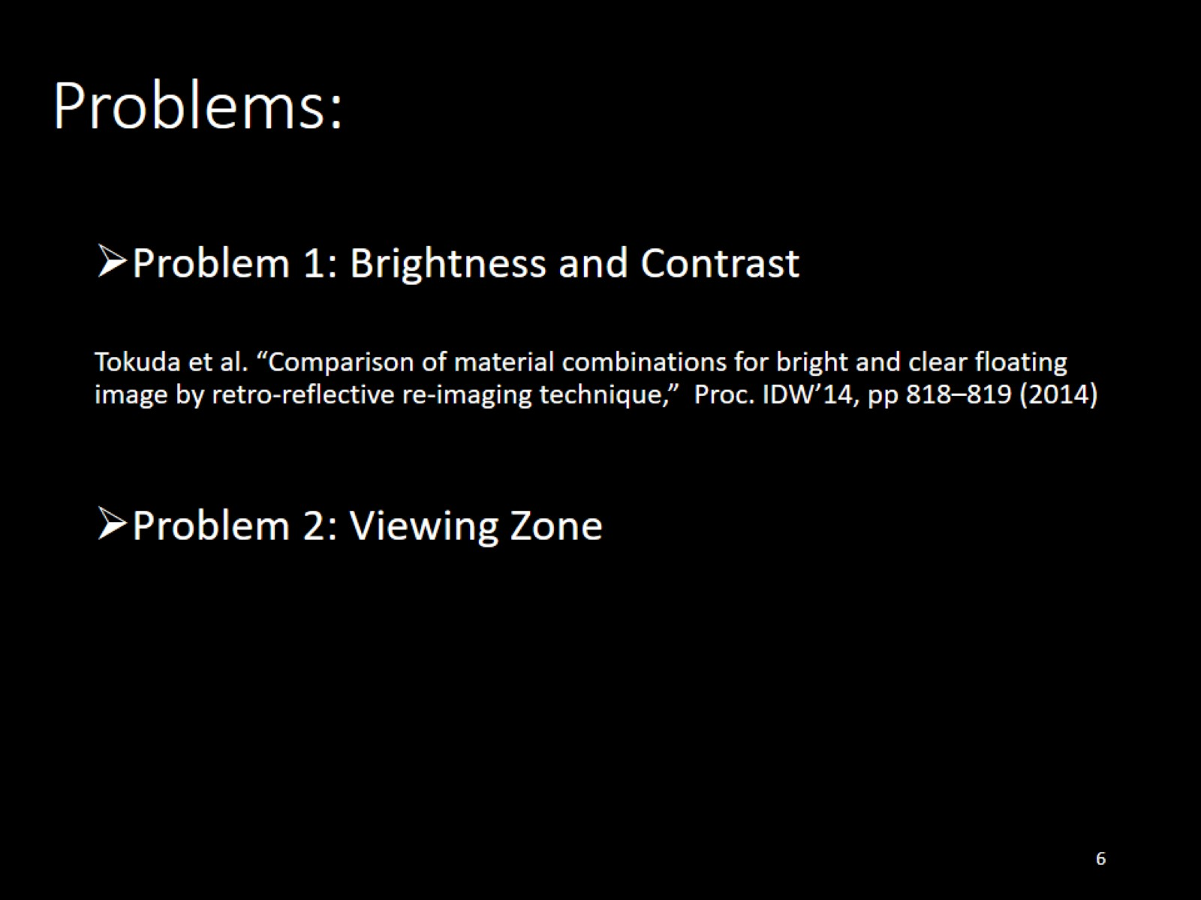

Slide 7
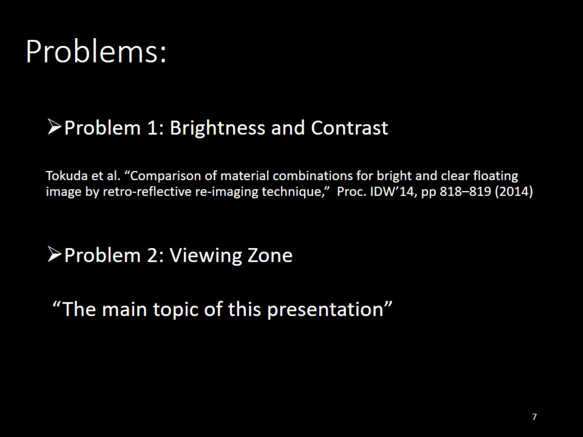

Slide 8
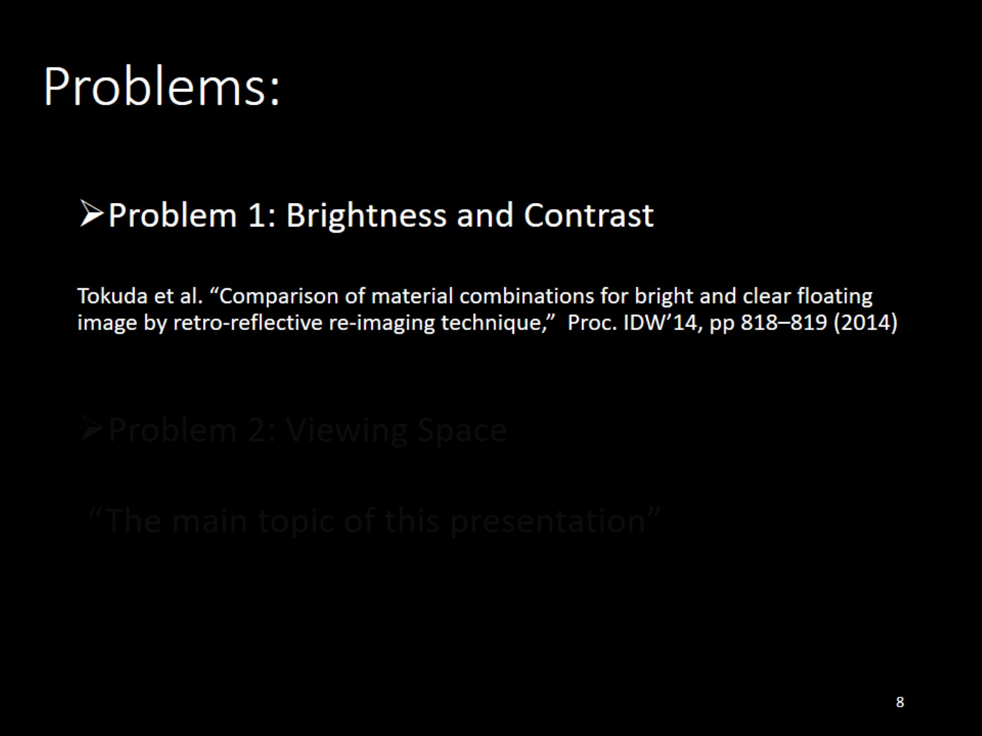

Slide 9
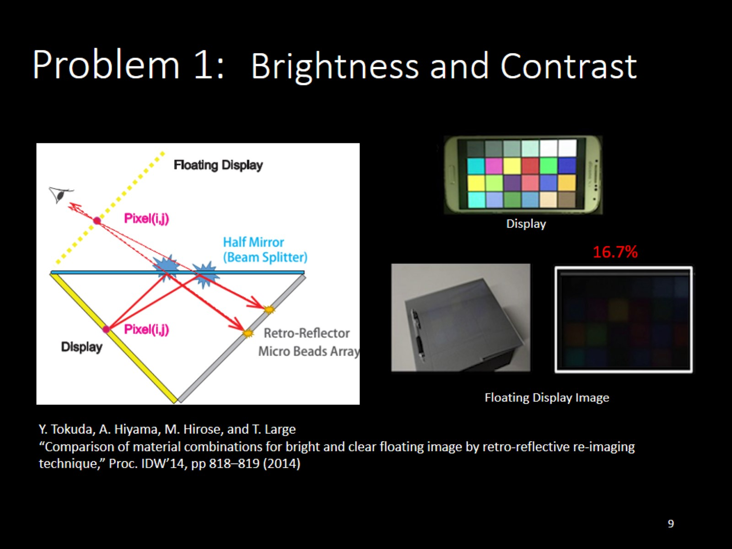
Brightness and Contrast

Slide 10
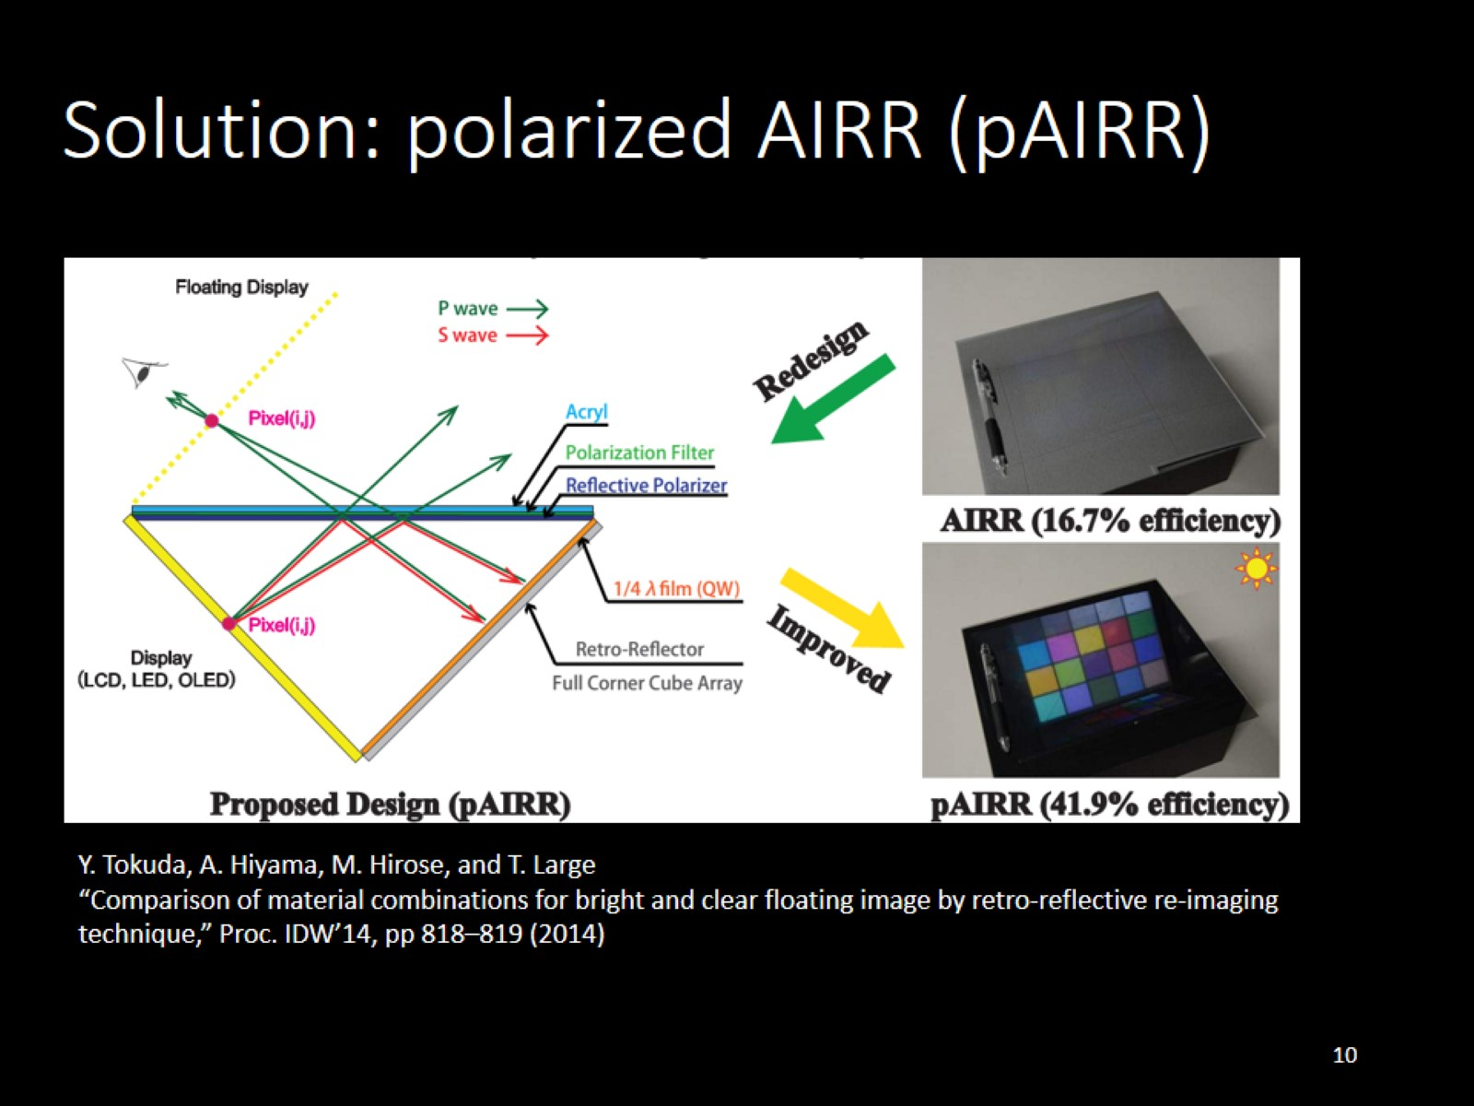
Solution: polarized AIRR (pAIRR)

Slide 11
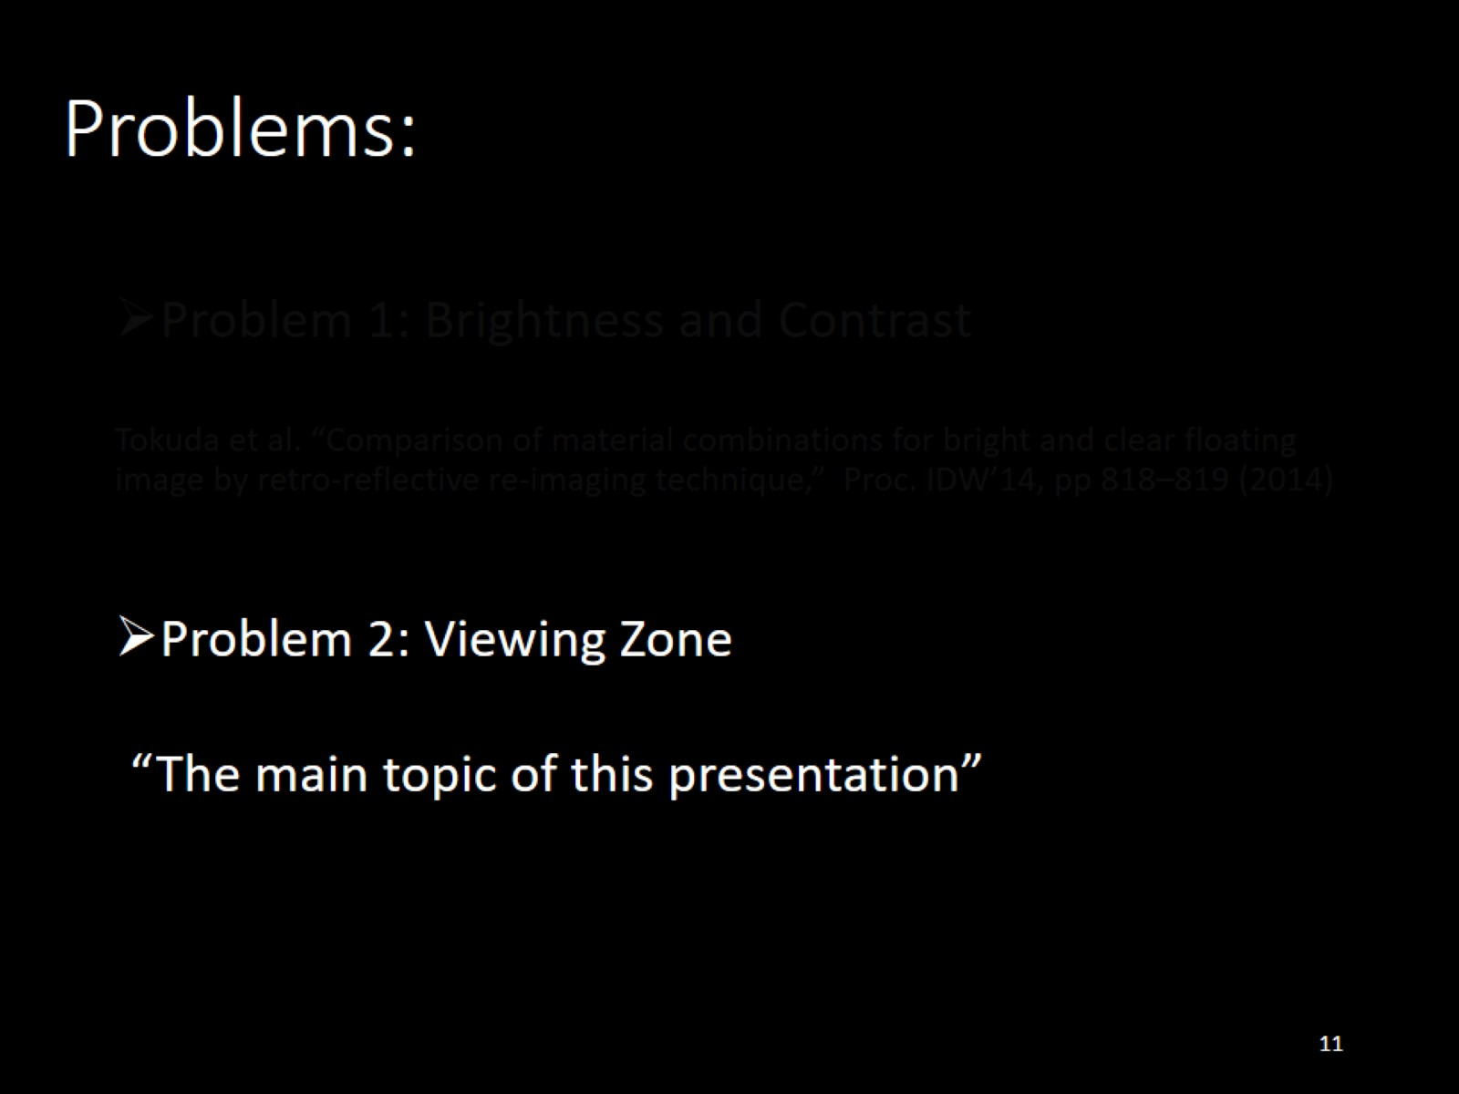

Slide 12
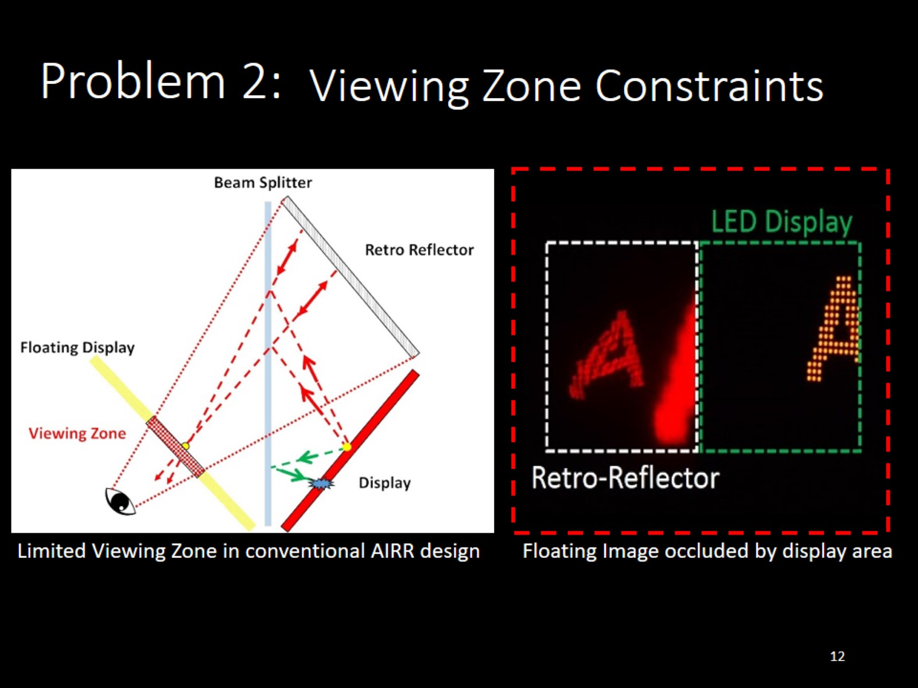
Viewing Zone Constraints

Slide 13
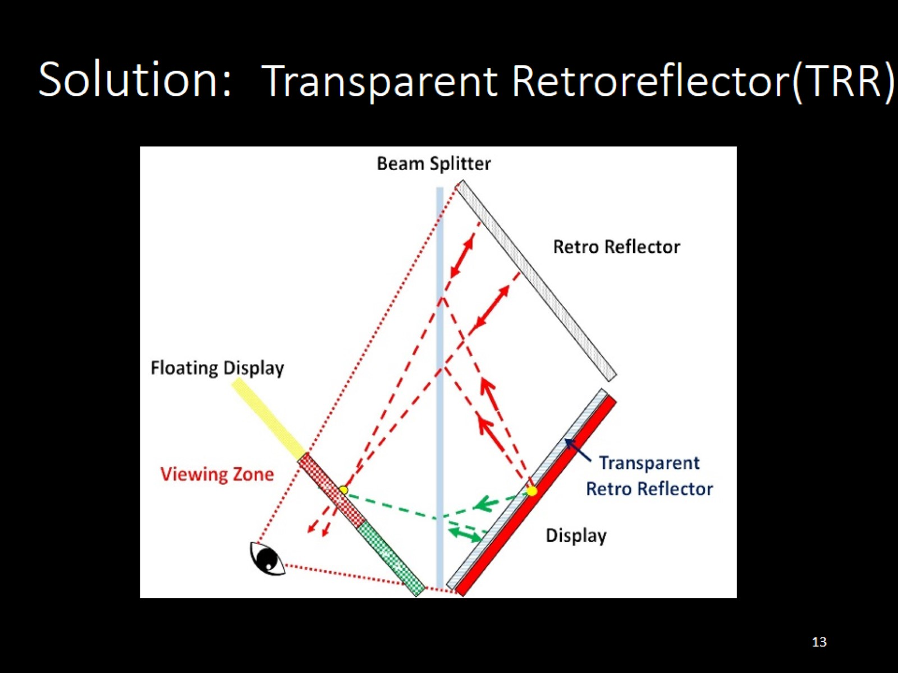
Transparent Retroreflector(TRR)

Slide 14
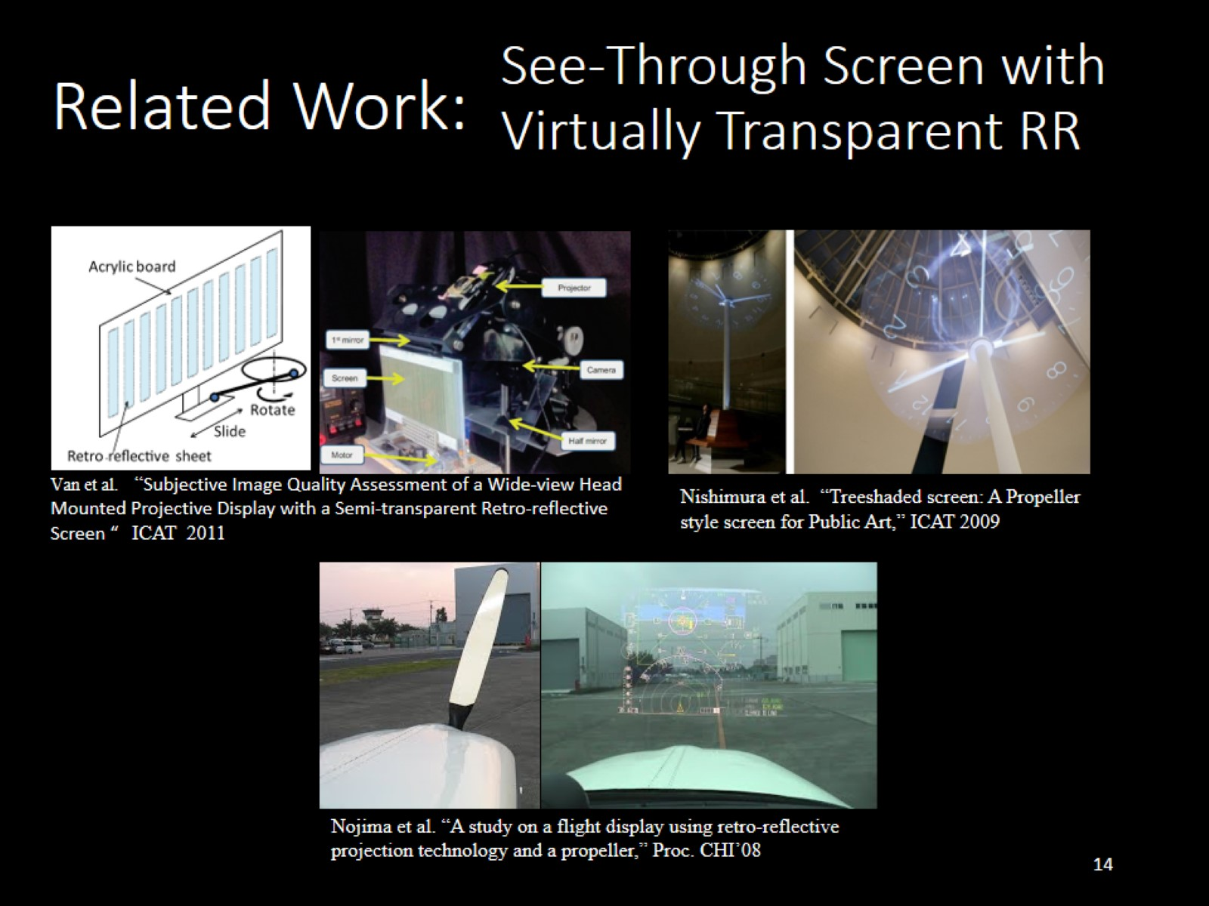
See-Through Screen with Virtually Transparent RR

Slide 15
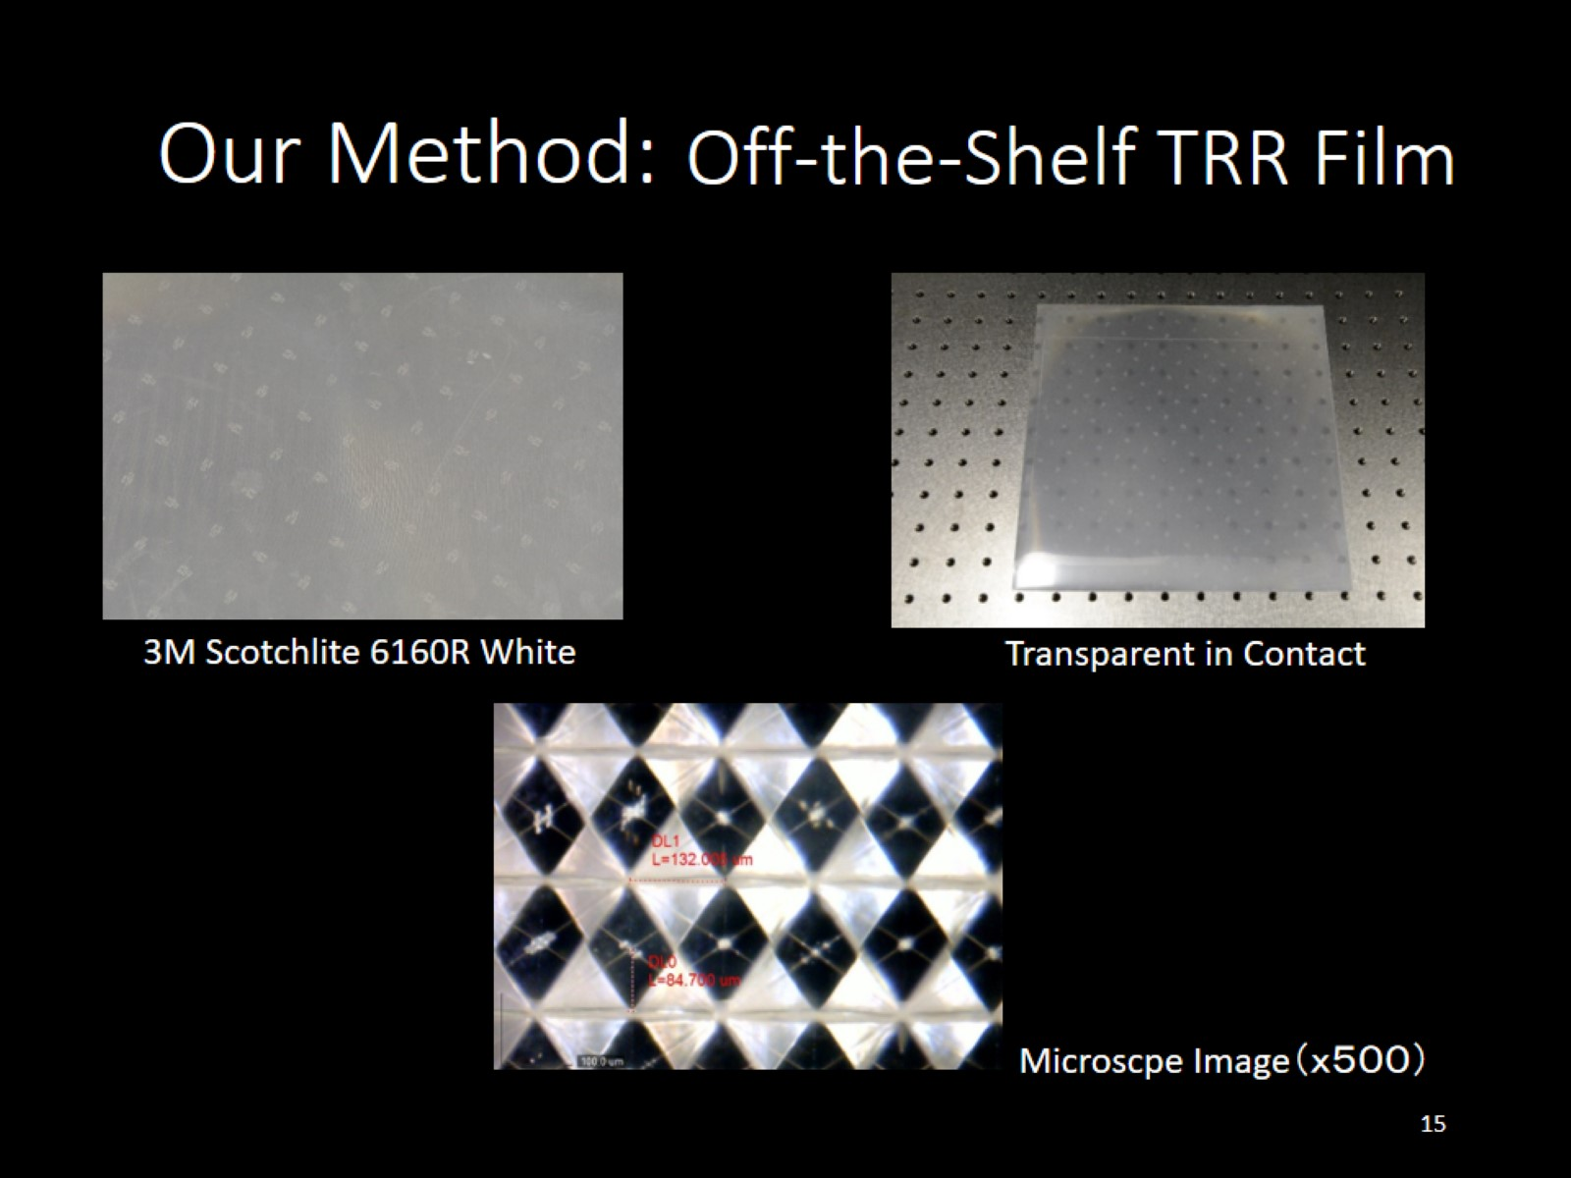
Off-the-Shelf TRR Film

Slide 16
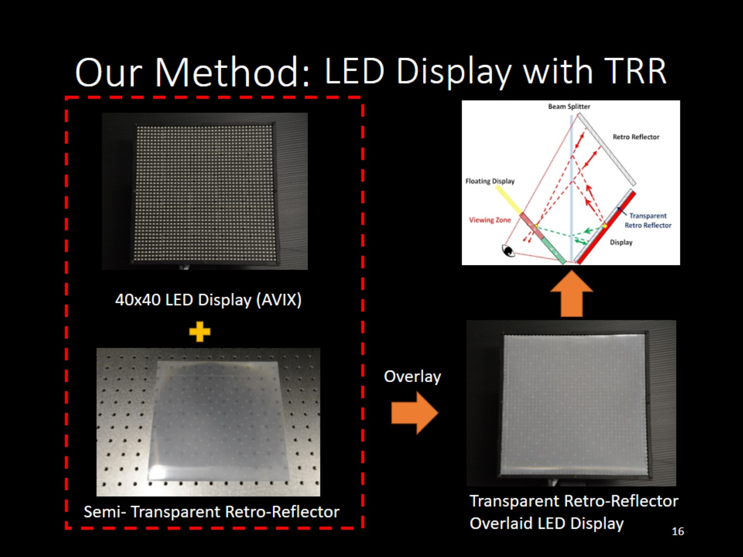
LED Display with TRR

Slide 17
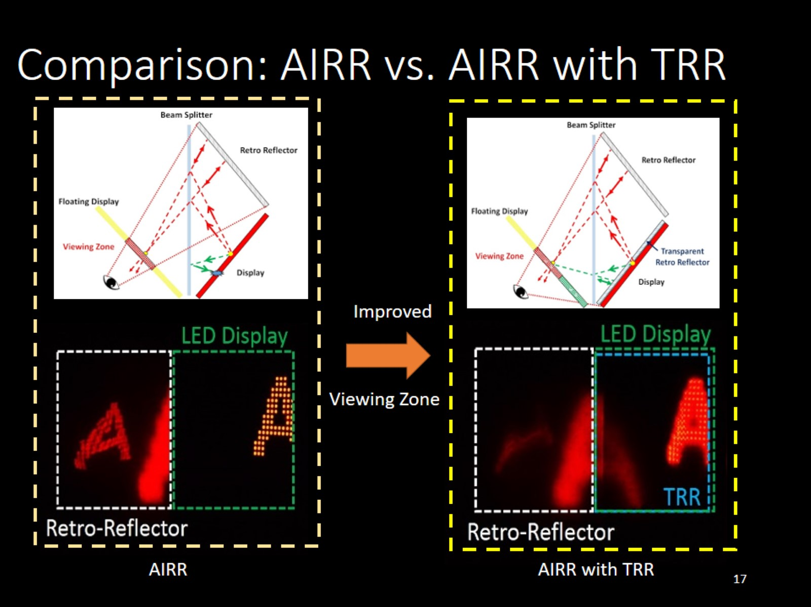

Slide 18

Application

Slide 19
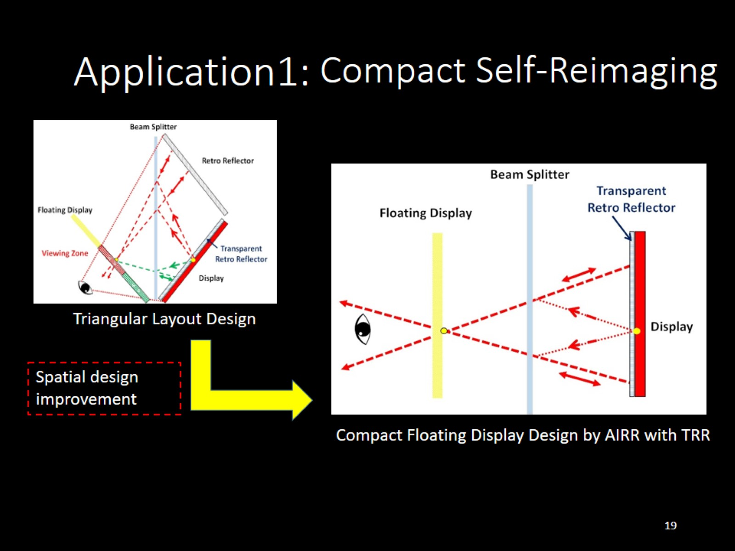
Compact Self-Reimaging

Slide 20
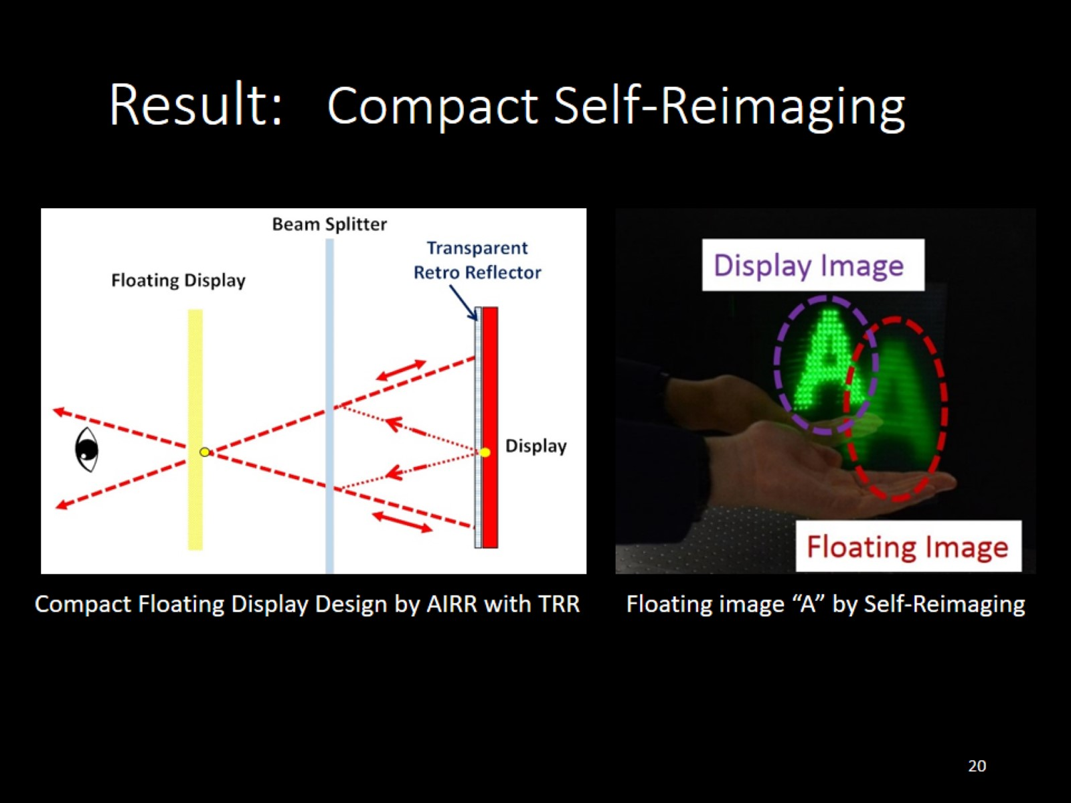
Compact Self-Reimaging

Slide 21
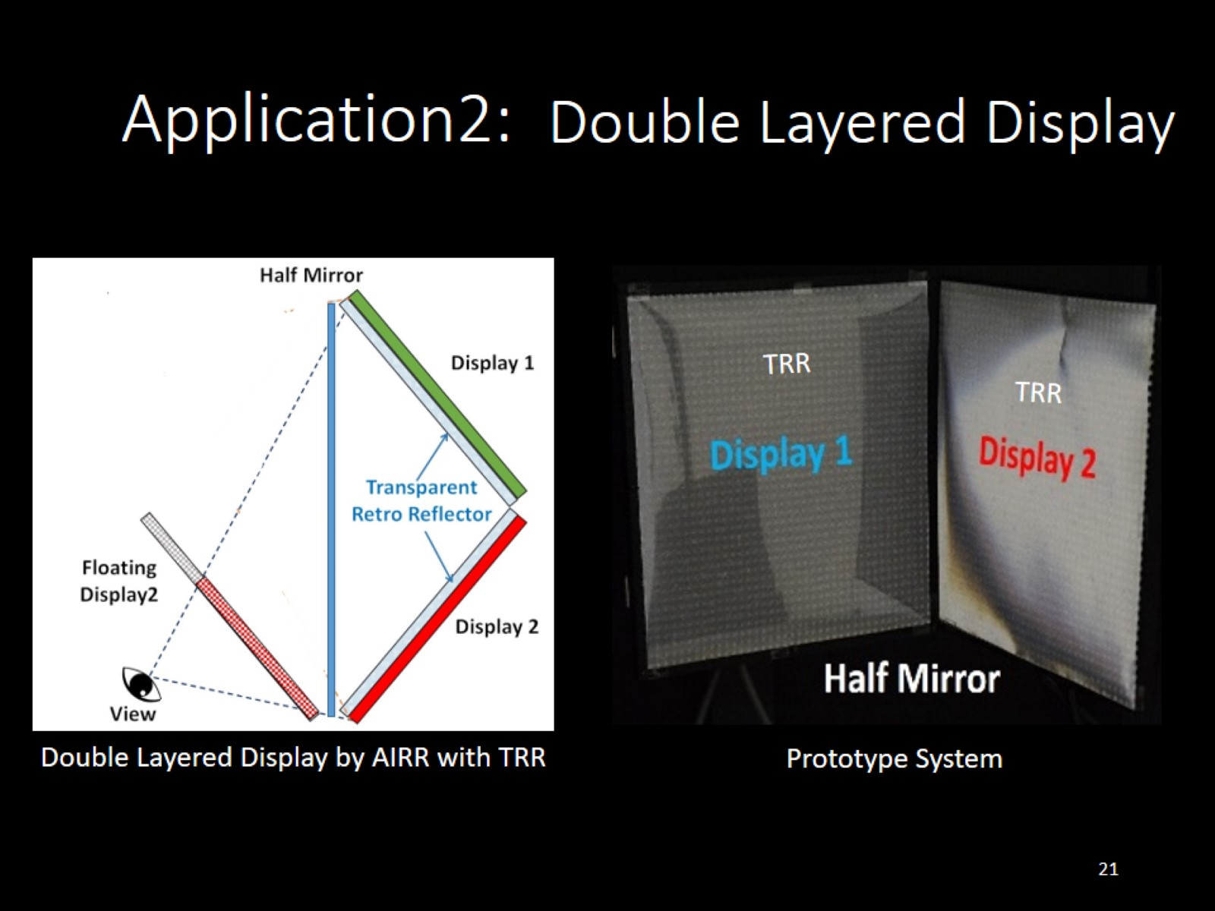
Double Layered Display

Slide 22
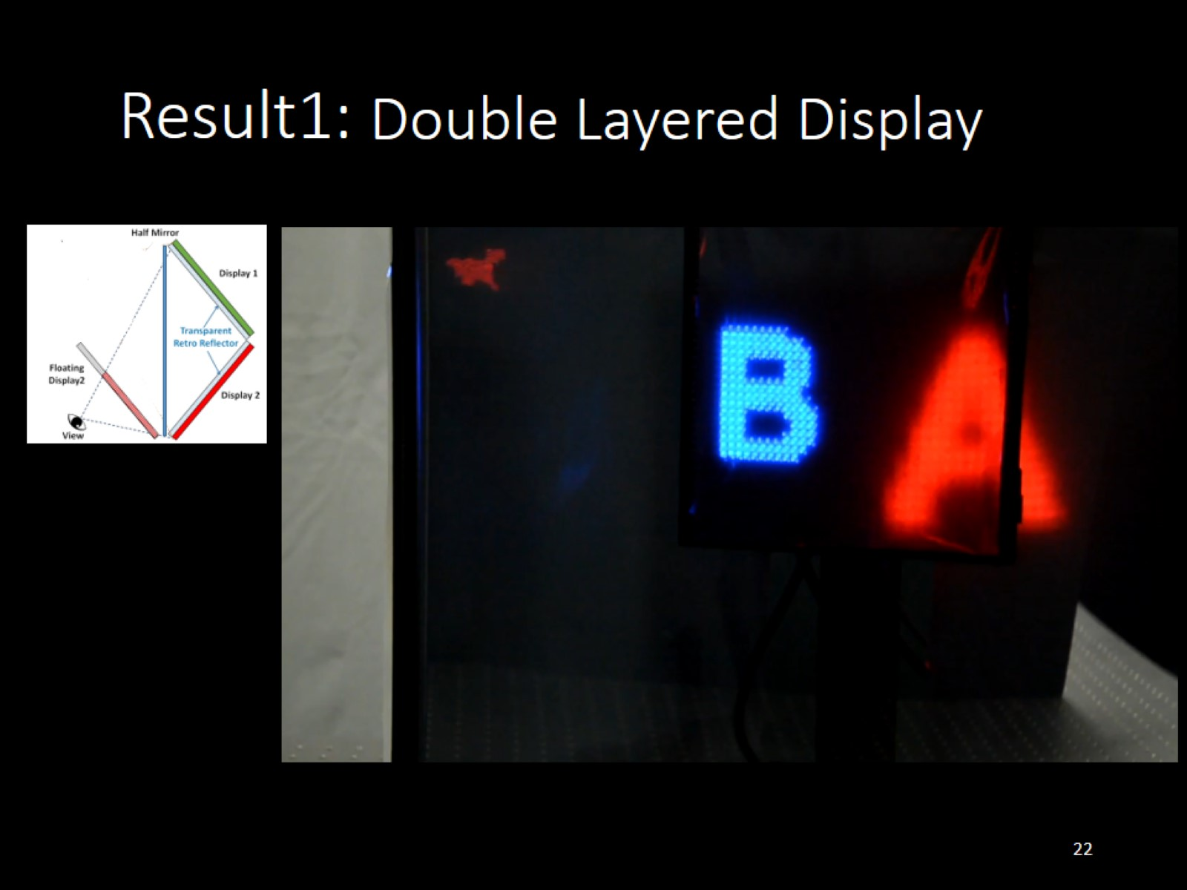
Double Layered Display

Slide 23
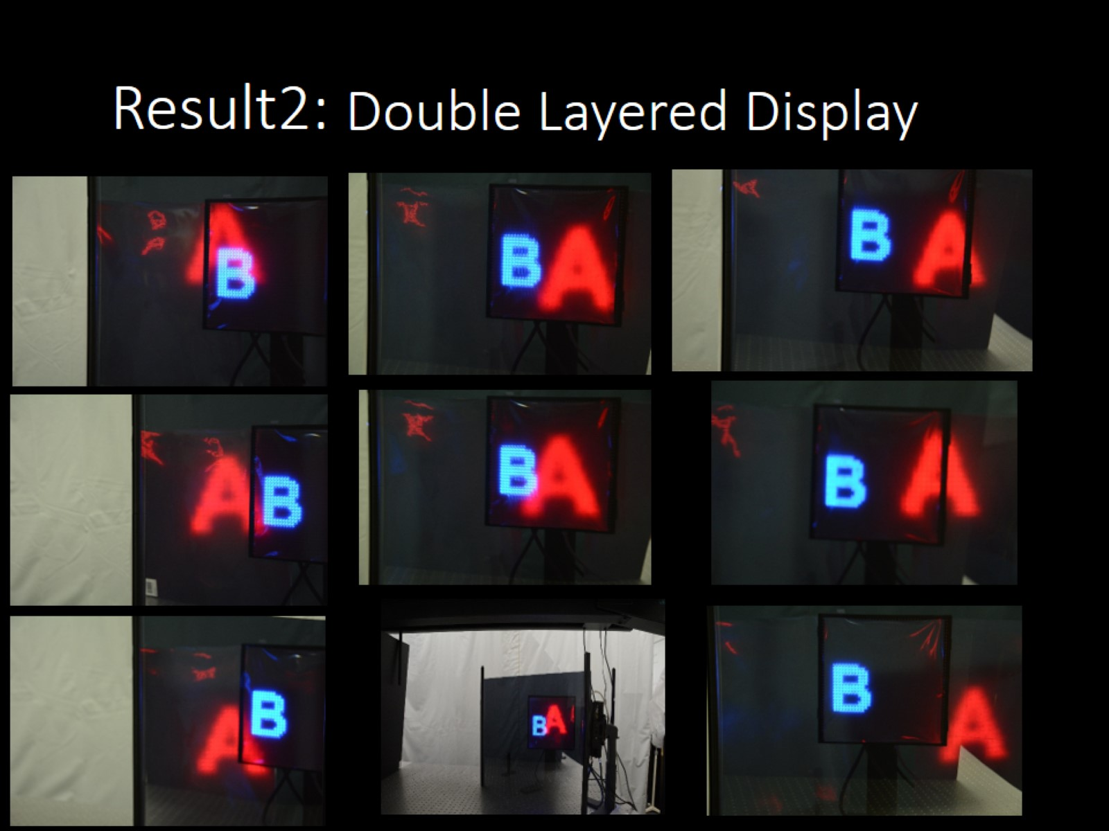
Double Layered Display

Slide 24
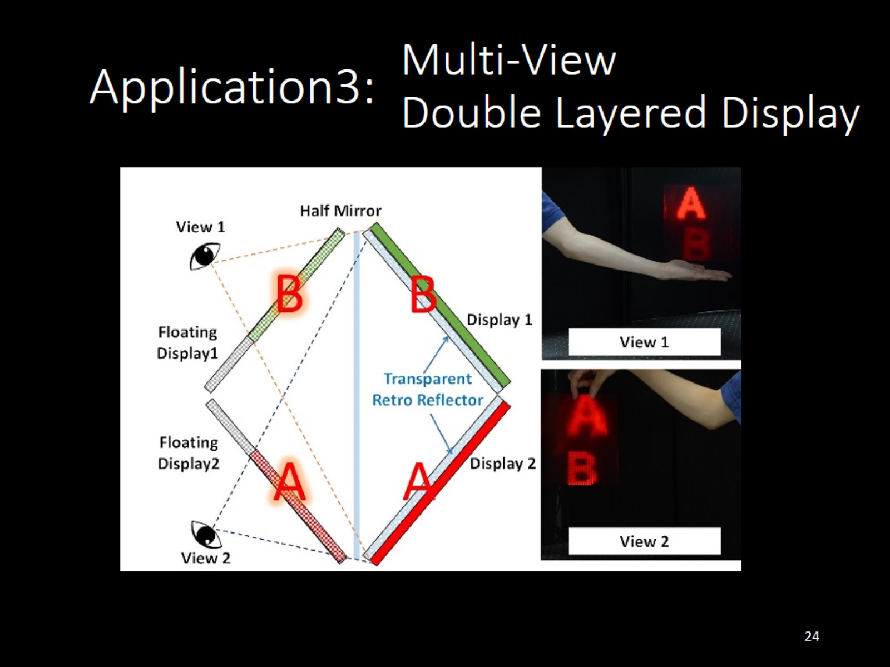
Multi-View Double Layered Display

Slide 25
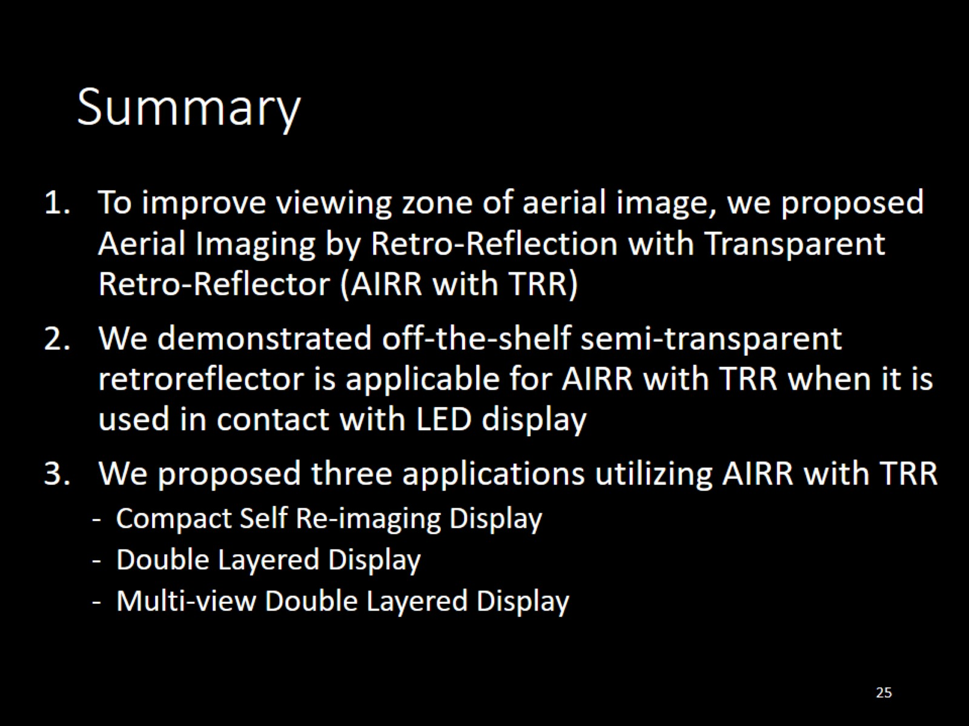
Summary

Slide 26
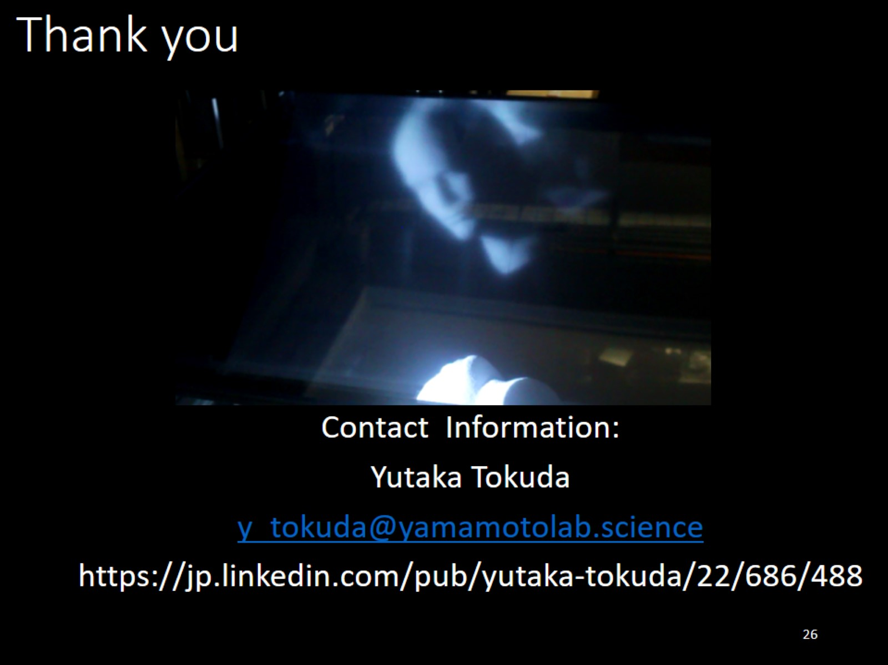
Thank you

Slide 27

Appendix

Slide 28
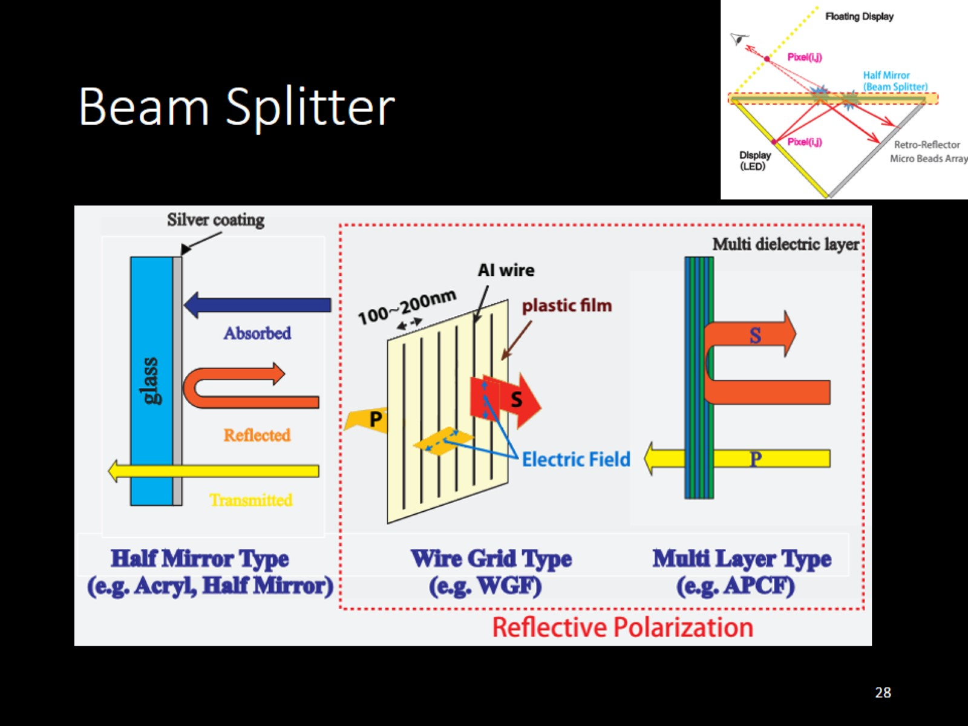
Beam Splitter

Slide 29
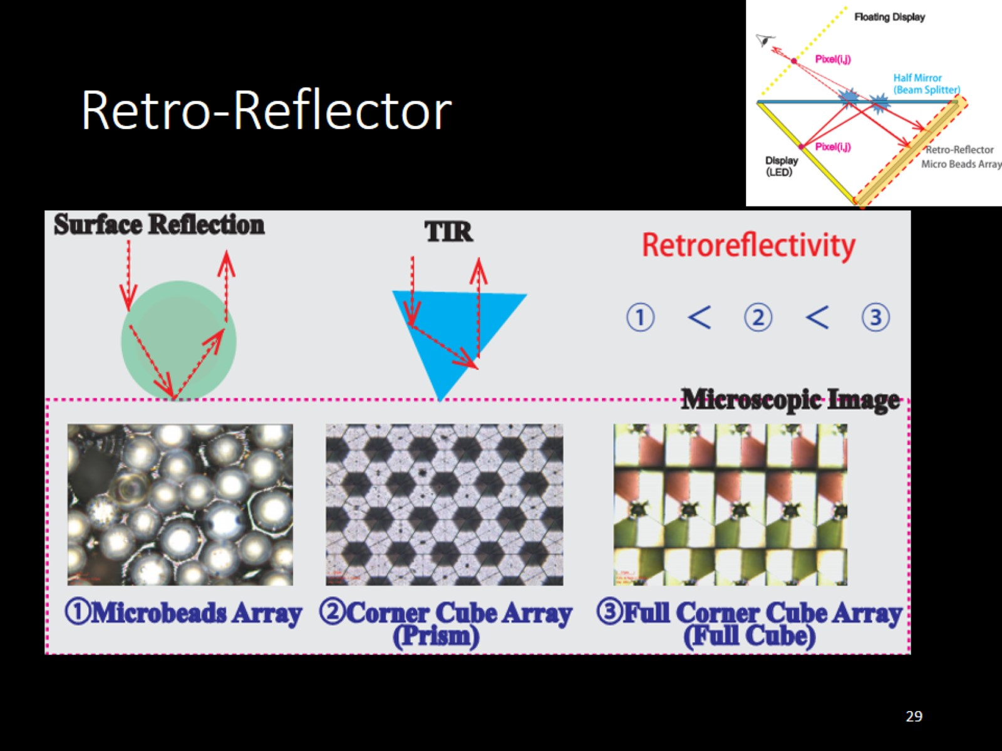
Retro-Reflector

Slide 30
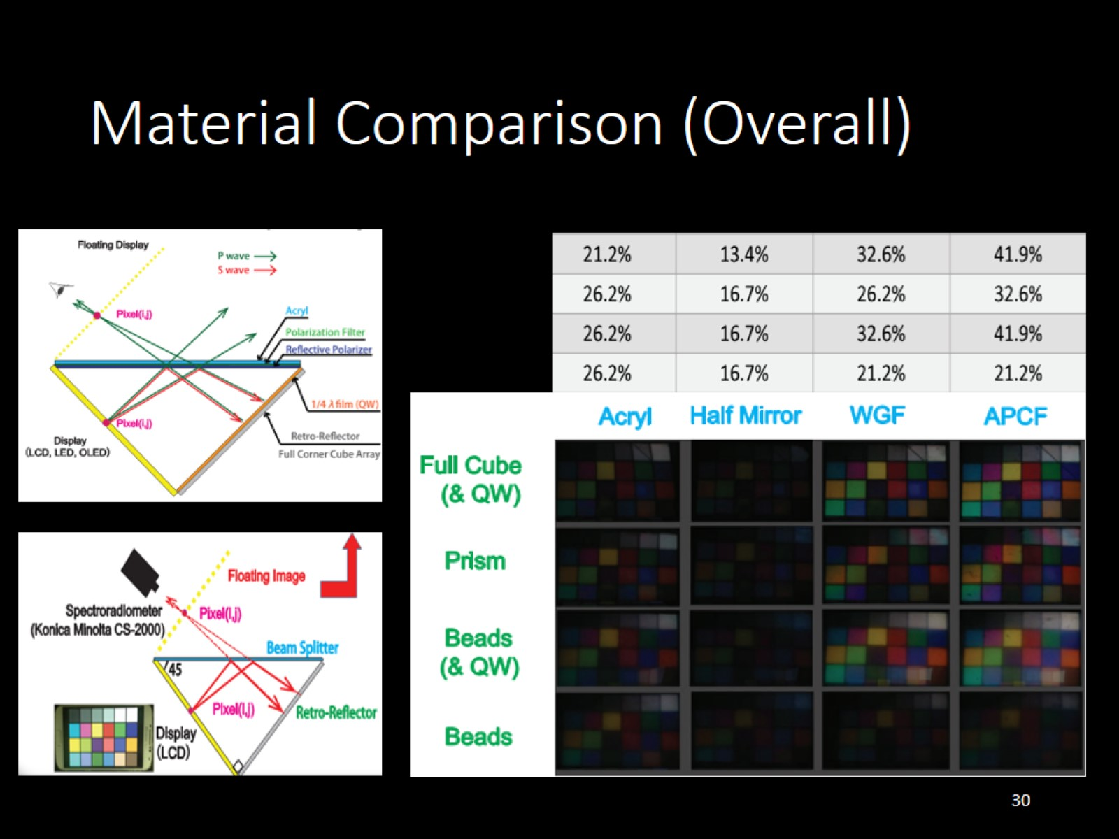
Material Comparison (Overall)

Slide 31
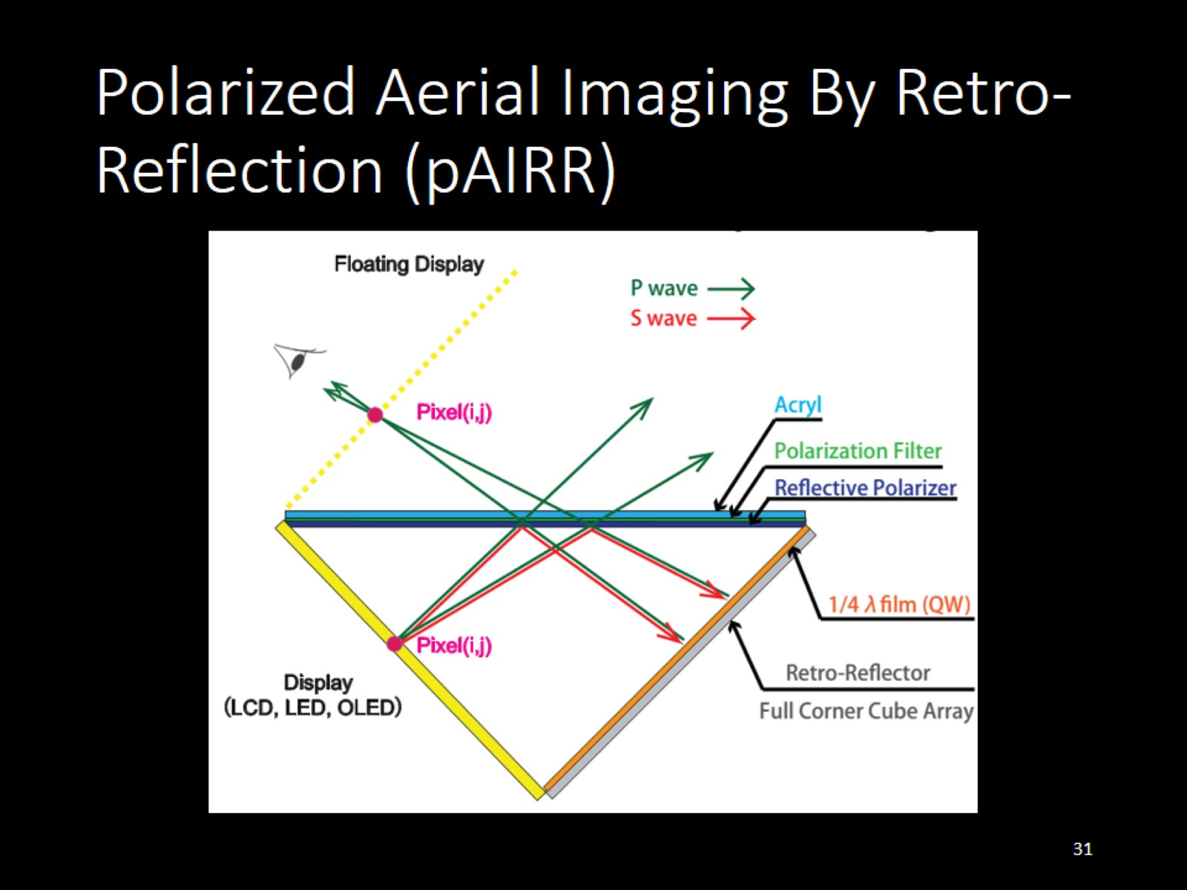
Polarized Aerial Imaging By Retro-Reflection (pAIRR)

